Slide 1
Module Development I
Creating a basic module

Slide 2


Introduction
Modules are the primary way of adding functionality to OpenMRS
Modules can be shared with others and published on the OpenMRS website
Non-programmers can install them without writing code

Slide 3
OpenMRS as a platform
OpenMRS isn't really an application - on its own it doesn't have very much useful functionality for a clinic
It's a flexible platform on which people can build modules to satisfy specific needs...
Primary care module
MDR-TB module
Reporting
module
Logic module
Form entry
module
Your module ??

Slide 4
Module capabilities
Add new pages
Add items to existing pages
Completely override existing pages
Add a new database tables
Add new services (which can provide new functionality to other modules)

Slide 5
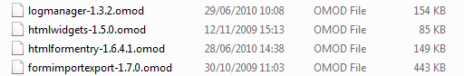
Modules
A module IS...
A JAR file containing classes and other resources
Renamed to have the *.omod extension
A module is NOT...
A runnable Java program
A separate web application

Slide 6
Creating a module
You could create a new Java project from scratch... but its a lot easier to start with an existing module... like...
Basic Module: basic skeleton module http://svn.openmrs.org/openmrs-modules/basicmodule/
AwesomeExample Module: has an example DAO and service http://svn.openmrs.org/openmrs-modules/devexamples/jsp-and-service/

Slide 7
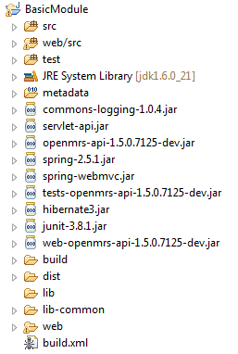
Source folders
Required libraries
OpenMRS API library
OpenMRS Web API library
Temporary build folder
Final output folder
Ant build script

Slide 8
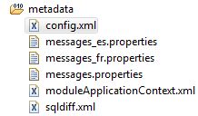
Metadata
XML configuration with module properties
Localization files
Beans for Spring application context
SQL scripts for creating module tables etc

Slide 9
config.xml
Unique id
Base Java package of module classes
Module id should be unique - if your module will be published you should request an id from code@openmrs.org
<module configVersion="1.2">
<id>basicmodule</id>
<name>Basic Module</name>
<version>1.0</version>
<package>org.openmrs.module.@MODULE_ID@</package>
...
</module>
@MODULE_ID@ is replaced by the value of the <id> tag
and @MODULE_PACKAGE@ by the value of the <package> tag

Slide 10
config.xml
Class which handles module being started and shutdown
Saying that your module requires version 1.X of OpenMRS, implies that it will work and has been tested on version 1.X of OpenMRS !
<module configVersion="1.2">
...
<author>Ben Wolfe</author>
<description>Useful for creating other modules.</description>
<activator>@MODULE_PACKAGE@.BasicModuleActivator</activator>
<require_version>1.2.0.3400</require_version>
...
</module>
OpenMRS version required by this module

Slide 11
Creating a new module
We can use BasicModule as a starting point..
Change the basic information fields such as: id, name, author, description
Change the name of the module activator, and then also refactor the class name in the src folder
Rename bean ids and classes in the application context file, and refactor those classes in the src folder

Slide 12
Creating a new module
Modify the messages files to use the new module id
Update AdminList.java to use the new message ids and page URLs
Update the project name in build.xml
Run the build script...
Try deploying the new module in OpenMRS

Slide 13
References
http://wiki.openmrs.org/display/docs/Creating+Modules

